Slide 1

Biodiversity II – spatial scale
Petr Keil

Slide 2
Species-area relationship (SAR)
One of the few laws of ecology

Slide 3
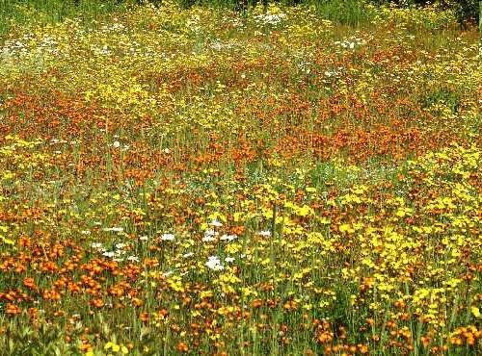
Species-area relationship: the basics

Slide 4
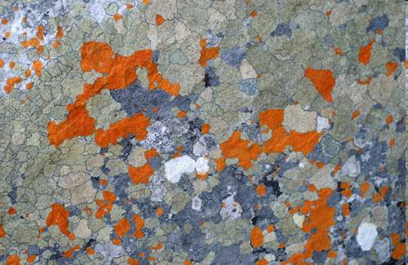
Species-area relationship: the basics

Slide 5
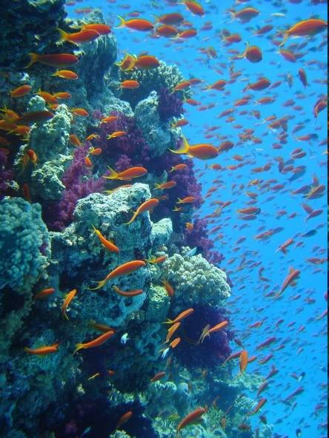
Species-area relationship: the basics
Note: This is more about volume

Slide 6
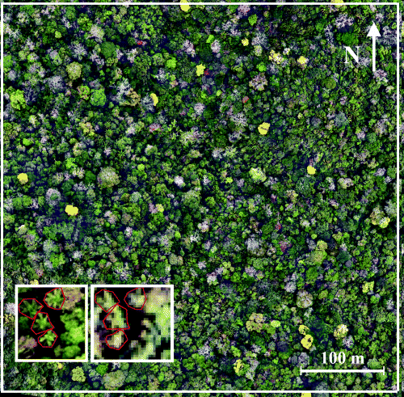
Species-area relationship: the basics

Slide 7
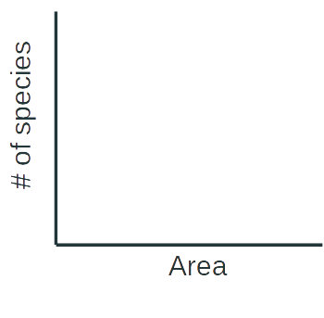

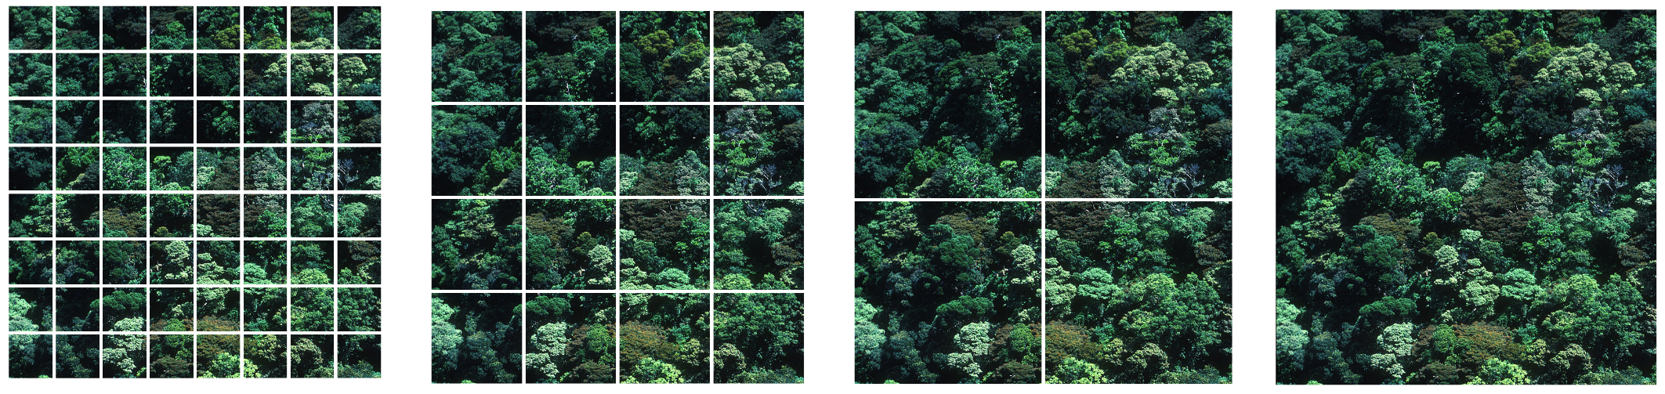
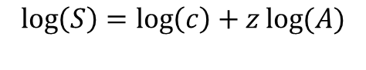
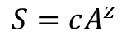
Species-area relationship: the basics
(S)
(S)
Power law (mocninná funkce)
$$S=cA^{z}$$
$$\log\left(S\right)=\log\left(c\right)+z\log{(A)}$$
log
(A)
log
(A)
Arrhenius (1921) Journal of Ecology

Slide 8
Species-Area Relationship: link between alpha, beta, and gamma diversity
γ
Slope of SAR is proportional to beta diversity. The steeper the SAR, the higher beta diversity.
(S)
α
β=γ/α
log
log
(A)

Slide 9
Species-Area Relationship: link between alpha, beta, and gamma diversity
γ
(S)
Slope of SAR is proportional to beta diversity. The steeper the SAR, the higher beta diversity.
α
β=γ/α
log
log
(A)
High beta diversity
Low beta diversity
The slope of SAR (beta diversity) reflects species spatial aggregation.
γ
γ
α
α

Slide 10



Local, regional, and continental SAR
Rescaled # of species
Rescaled Area
Log Area
Storch, Keil & Jetz (2012) Nature
Keil, Storch & Jetz(2015) Nature Communications

Slide 11
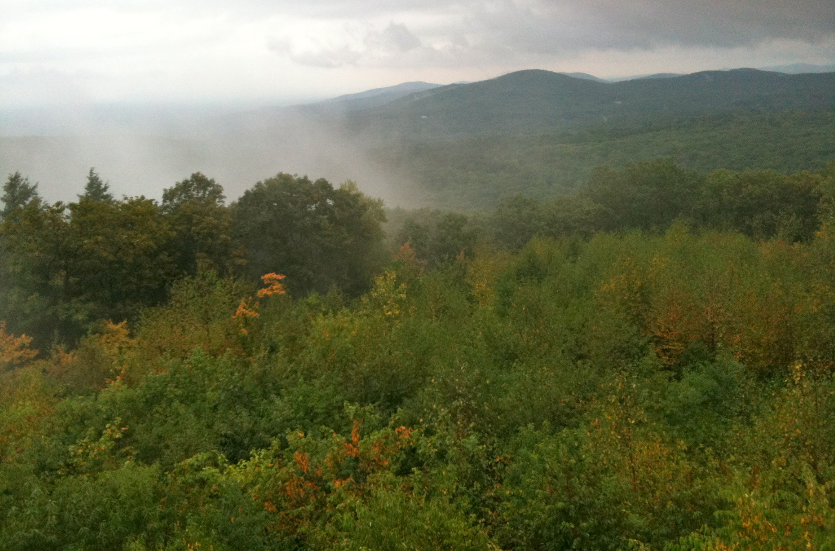
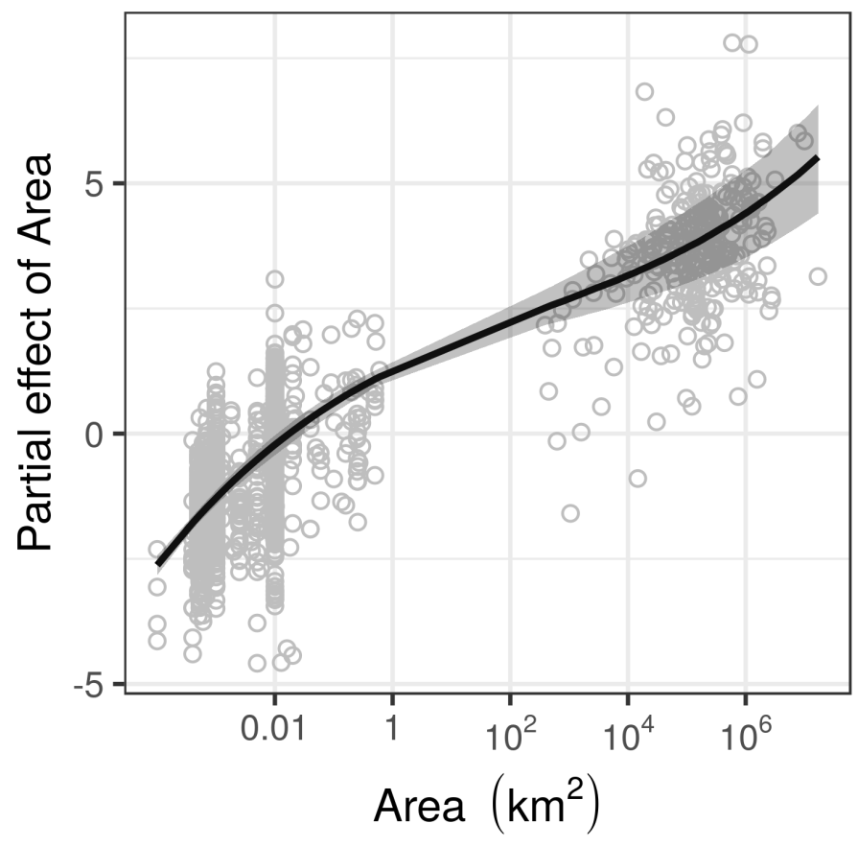
Local, regional, and continental SAR – the tri-phasic function
Theoretical expectation
Empirical relationship in global forests
Local
Continental
Storch (2016) Journal of Vegetation Science
Keil & Chase (2019) Nature Ecology and Evolution

Slide 12
You should know
Number of species monotonically increases with area, following what is called a “species-area relationship” (SAR)
This is a real law of ecology
Over a limited extent of areas it can be approximated by a power function
From local to continental areas it is tri-phasic (s-shaped)
The slope of the species-area relationship is proportional to the ratio of alpha and gamma diversity, which is driven by species aggregation

Slide 13
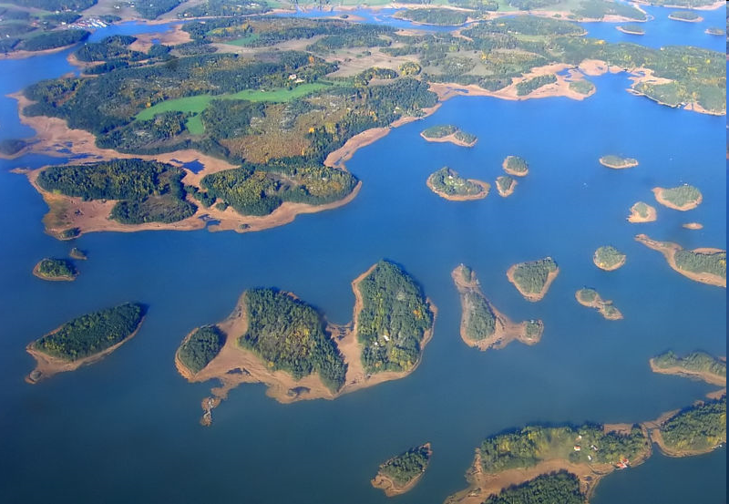
Island (non-nested) Species-Area relationship (ISAR)

Slide 14
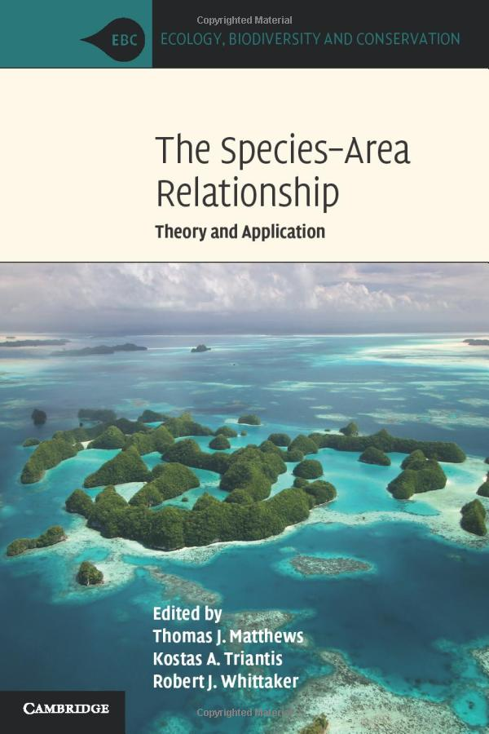
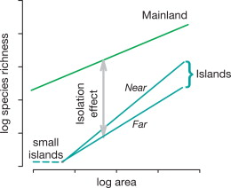
Island (non-nested) Species-Area relationship (ISAR)
Lomolino et al. (2006)

Slide 15
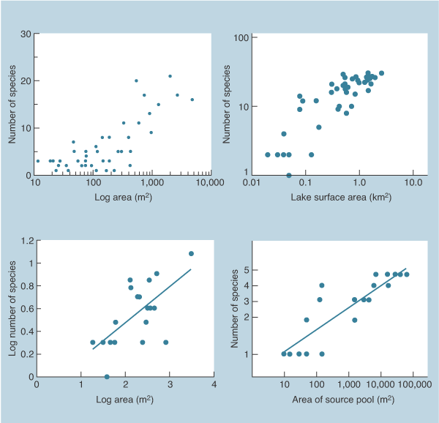
Island (non-nested) Species-Area relationship (ISAR)
plants on Bahamas
birds on Florida lakes
bats in Mexican caves
fish in Austr. ponds
Begon et al. (2010) Ecology: From individuals to ecosystems

Slide 16
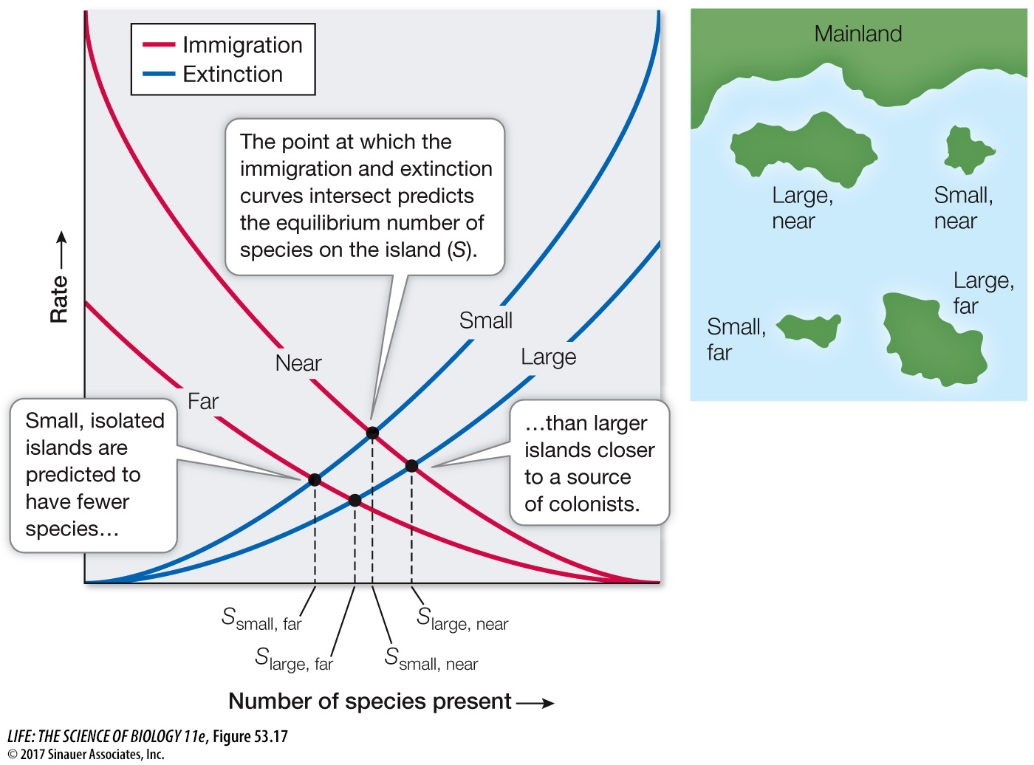
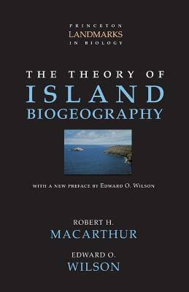
Islands: It’s not just their area, but also their “remotedness”
MacArthur & Wilson (1967) The Theory of Island Biogeography

Slide 17
Scale dependence of biodiversity patterns

Slide 18
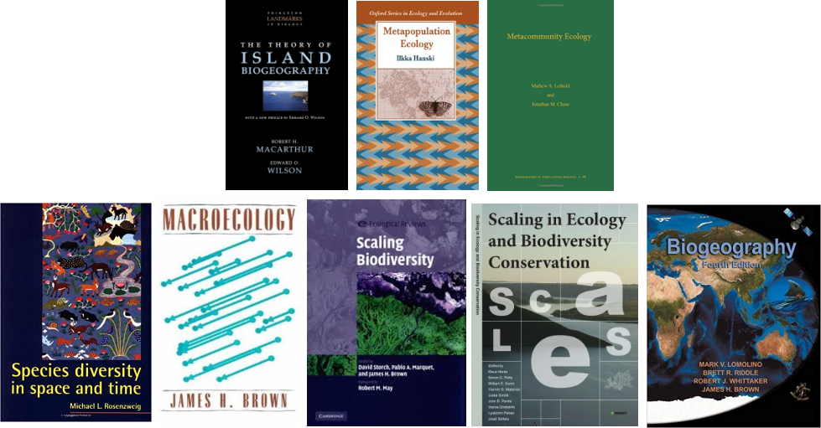
Because of SAR, practically everything about biodiversity is grain-dependent

Slide 19
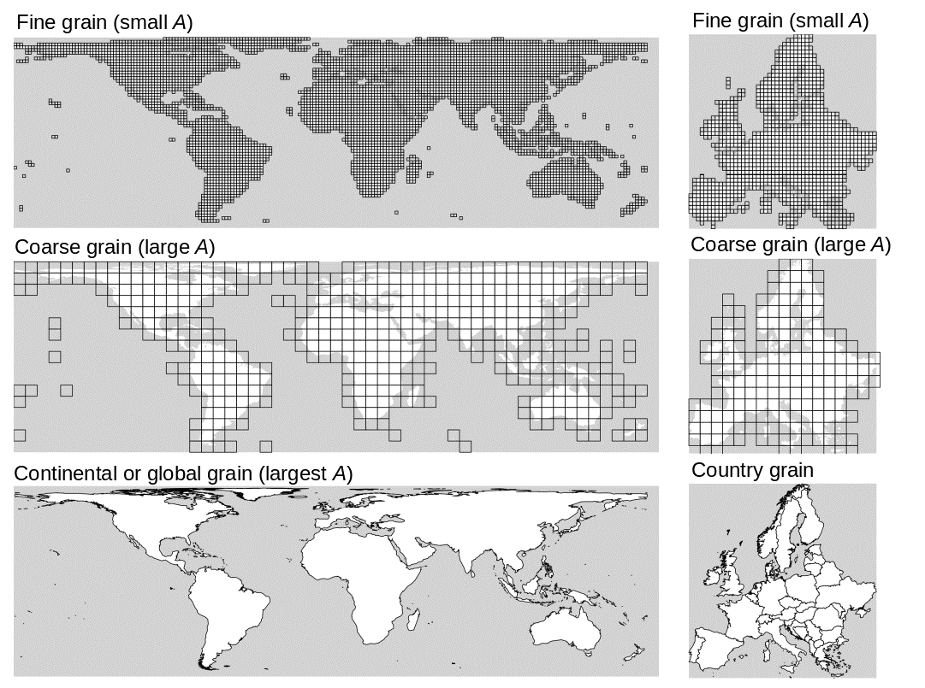
Because of SAR, practically everything about biodiversity is scale-dependent
What is scale?
Scale is the most general term with vague meaning, and has several more precise facets:
Grain is the resolution, i.e. average area of a spatial unit
Extent is the area of the entire region over which we overlay the grid
Support, or cover, is the total number of grid cells, it is the “fill” of the grid

Slide 20
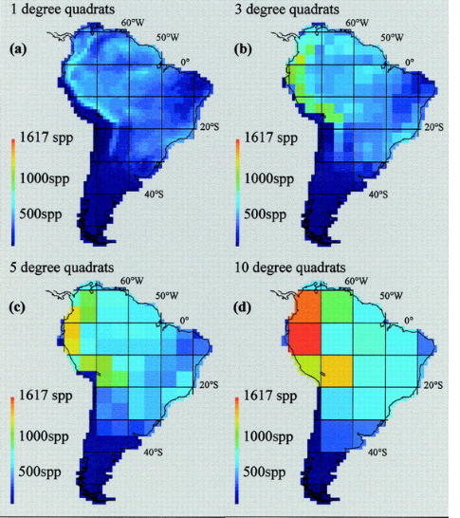
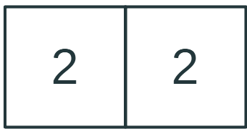
Spatial patterns of biodiversity are grain-dependent
Species richness of South-American birds
?
High beta diversity
Low beta diversity
Rahbek & Graves (2001) PNAS
Notes:
In this panel we can probably all agree that biodiversity is one of the most valuable natural resources.
But things like climate change or habitat loss are a threat to biodiversity, to the extent that we hear about biodiversity crisis, or sixth mass extinction
For example, about 1% of vertebrate species have gone extinct because of humans

Slide 21
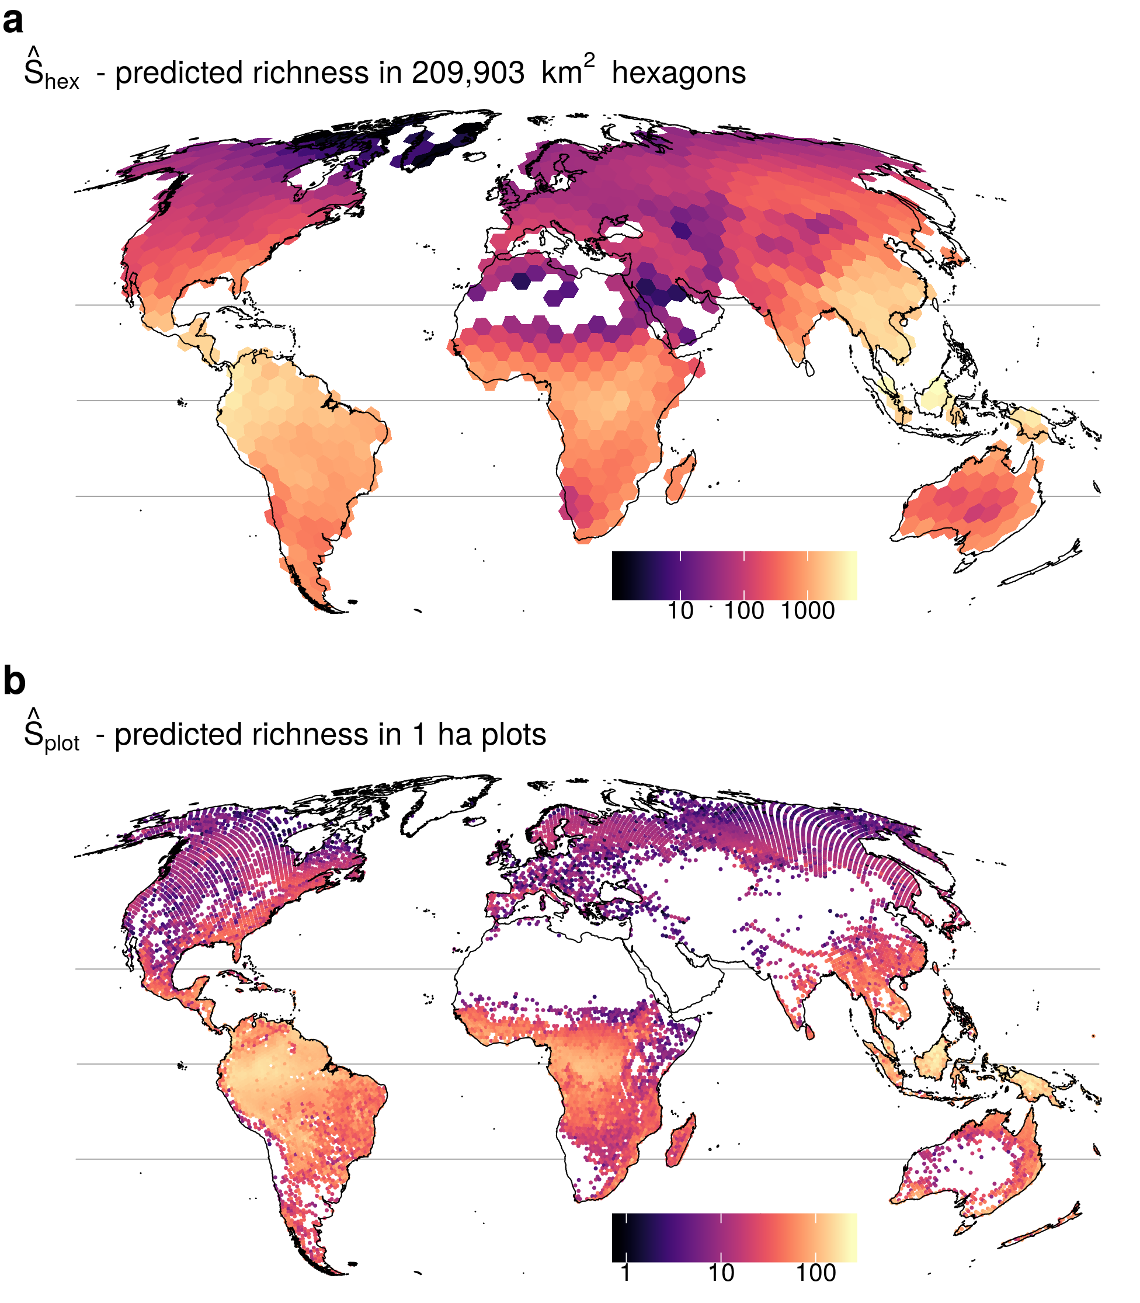
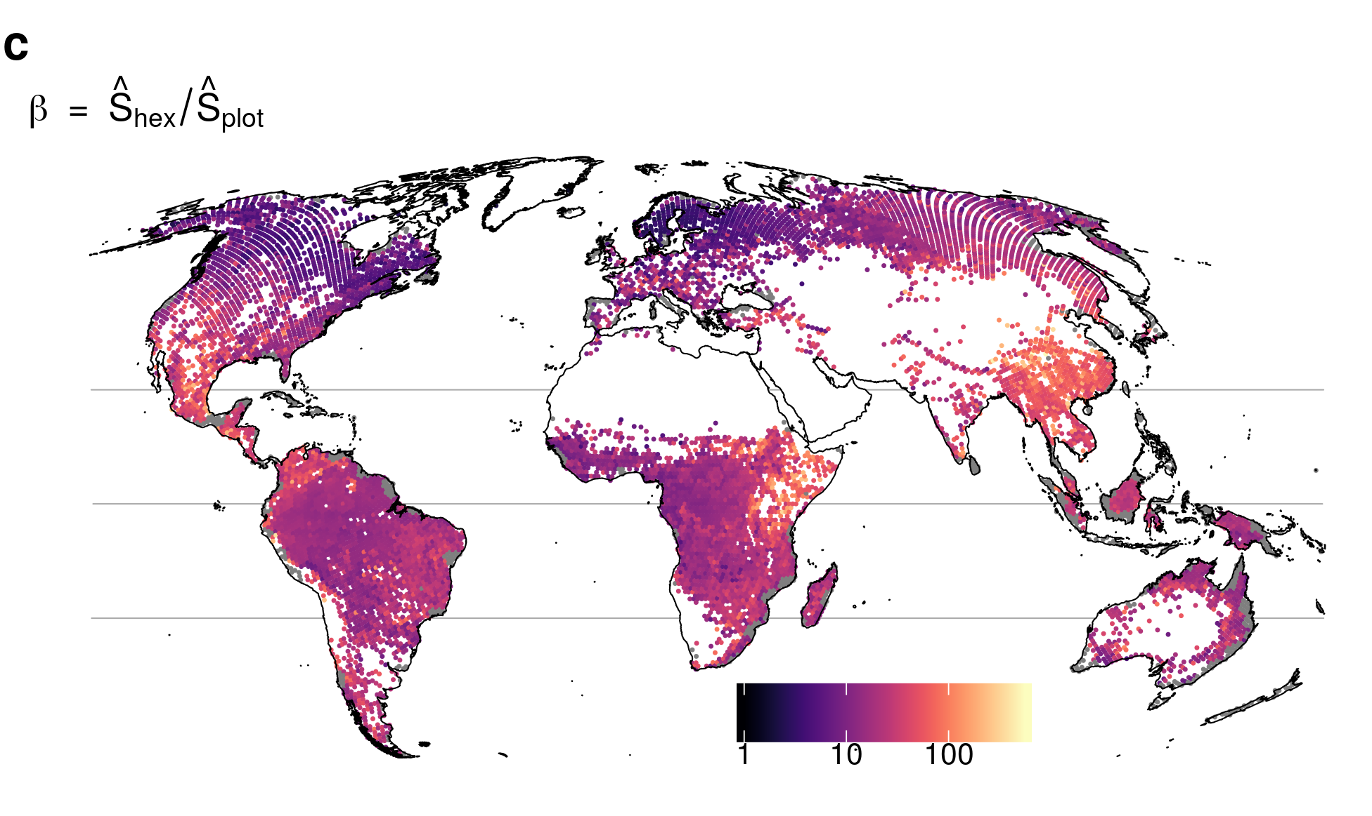
Spatial patterns of biodiversity are grain-dependent
Species richness of trees in forests
Beta diversity
Keil & Chase (2019) Nature Ecology and Evolution

Slide 22
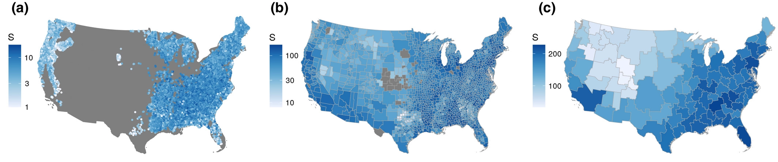
Environmental predictors of biodiversity are grain-dependent
Tree diversity in the US
Craven, … & Keil (2020) Global Ecology and Biogeography

Slide 23
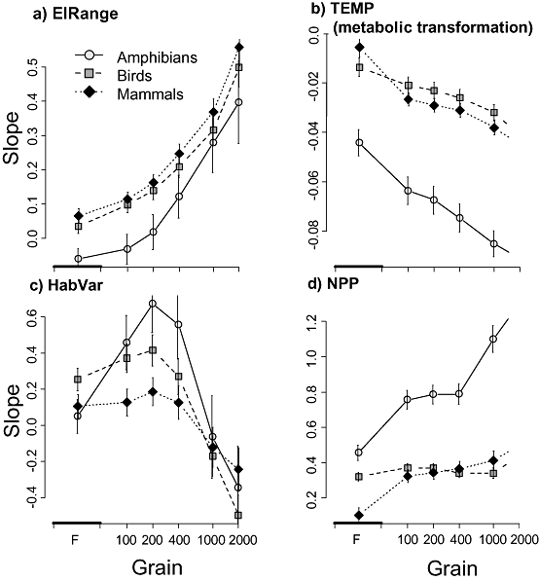
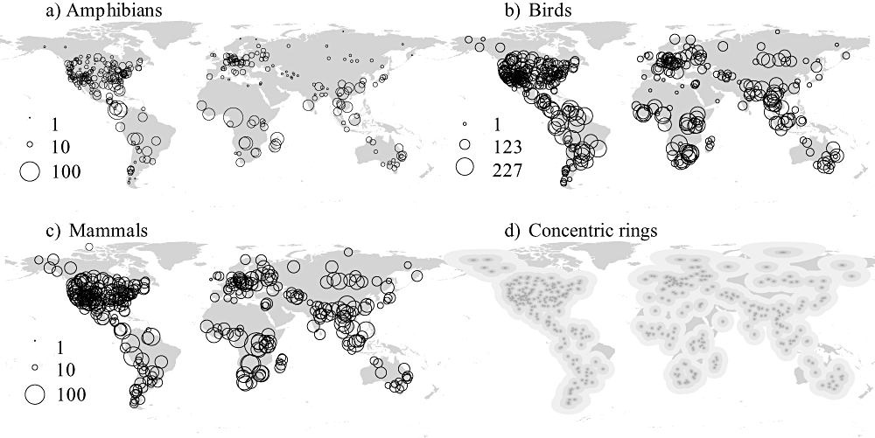
Effect of environment on biodiversity is grain-dependent
Belmaker & Jetz (2011) Glob. Ecol. Biogeogr.

Slide 24
Empirical patterns of scale-dependent biodiversity change

Slide 25
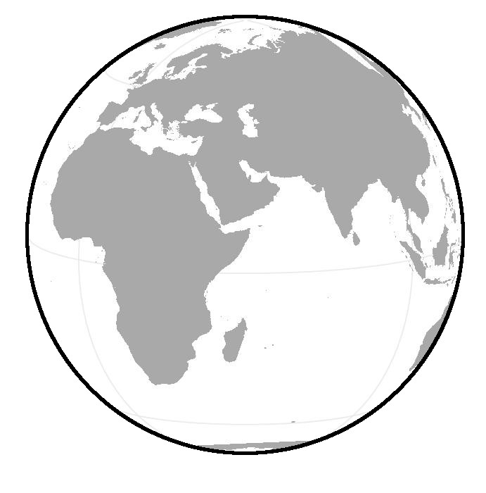
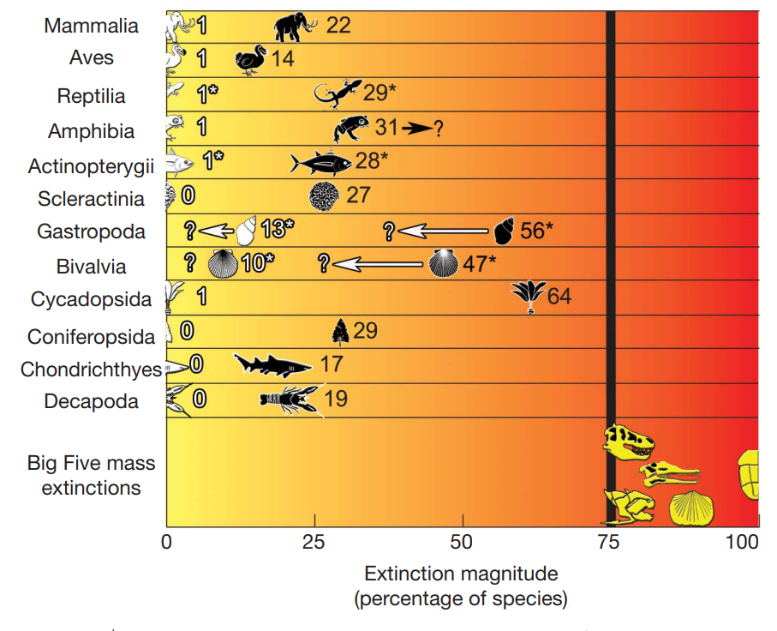
The Earth has been losing species
Barnosky et al. (2011) Nature

Slide 26

Reportedly, we are also experiencing the sixth mass extinction
Barnosky et al. (2011) Nature
Ceballos et a. (2015) Science Advances

Slide 27
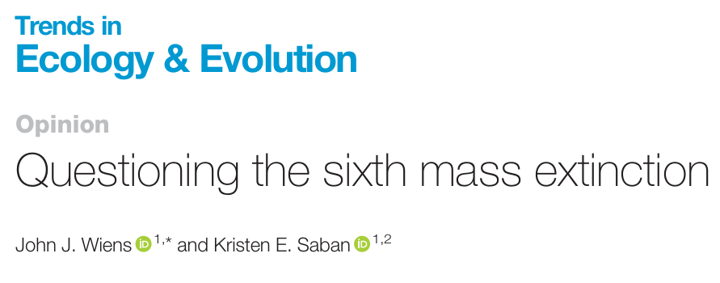
But there is a debate about whether this is the sixth mass extinction
Wiens & Saban (2025) Trends in Ecology and Evolution

Slide 28
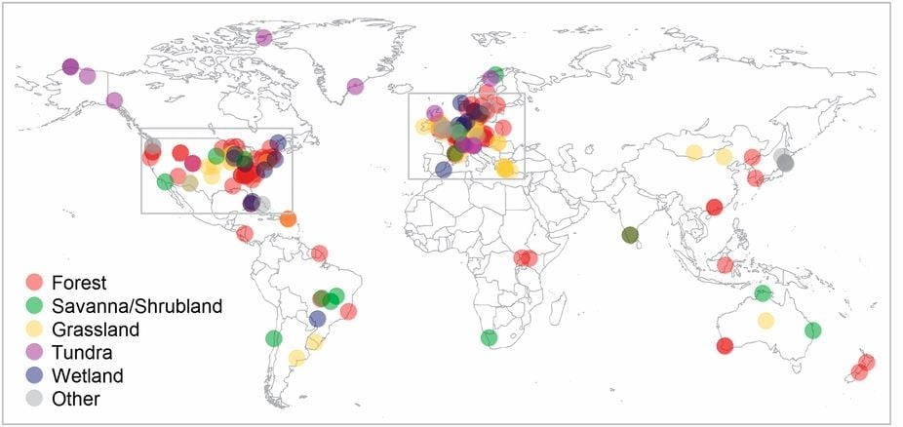
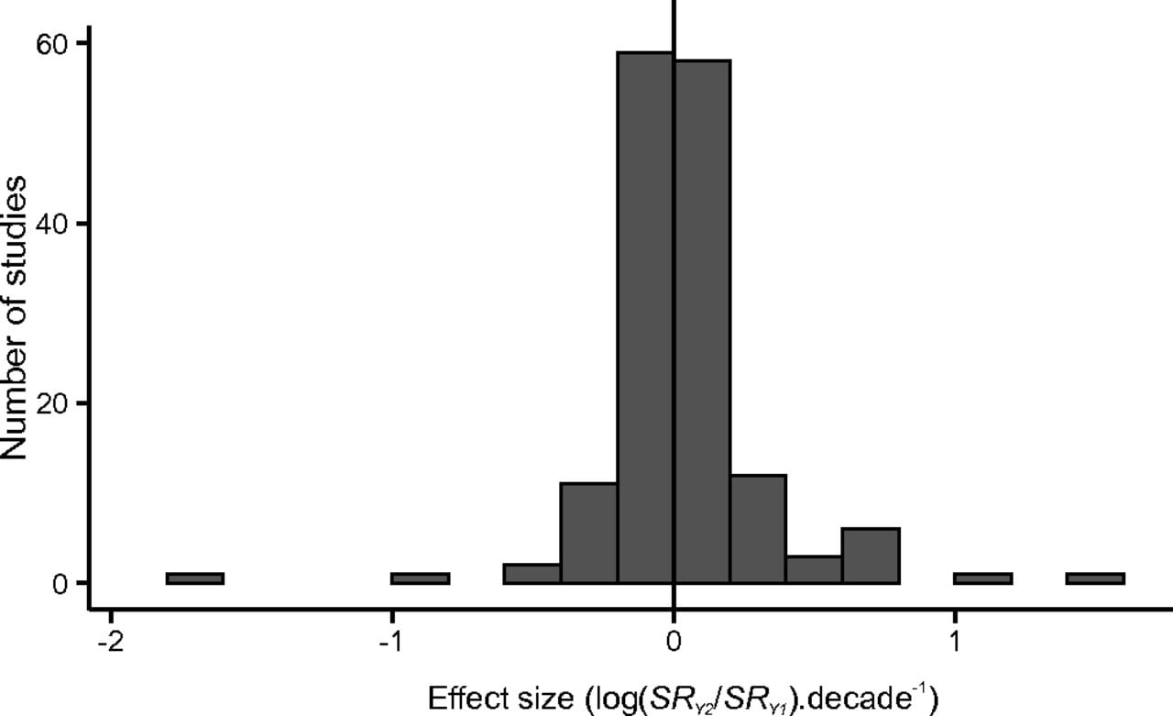
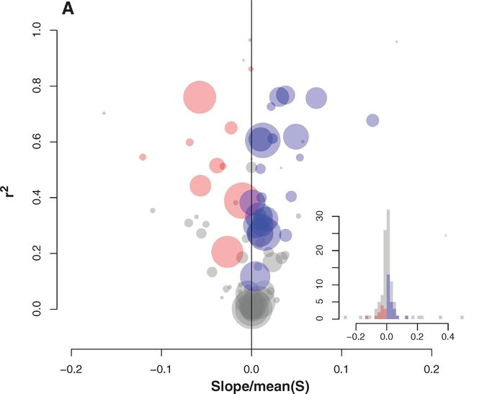
No average net change in species richness – the BioTime database
Vellend et al. (2013) PNAS, Dornelas et al. (2014) Science, Blowes et al. (2019) Science

Slide 29
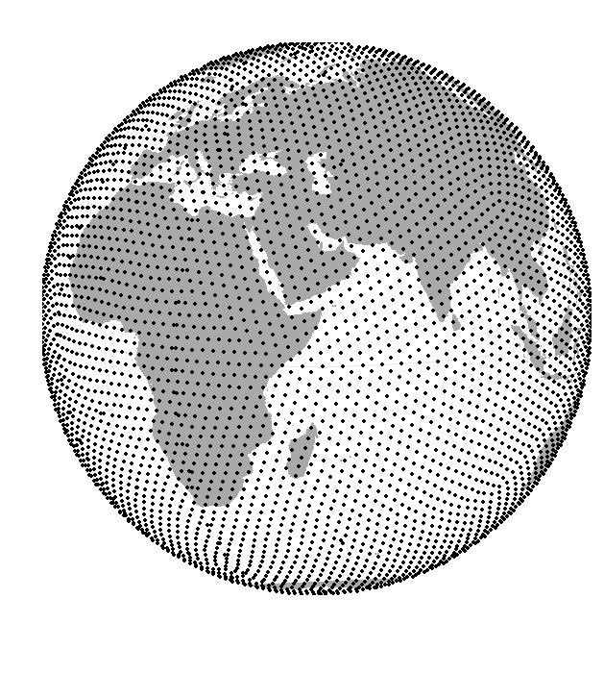
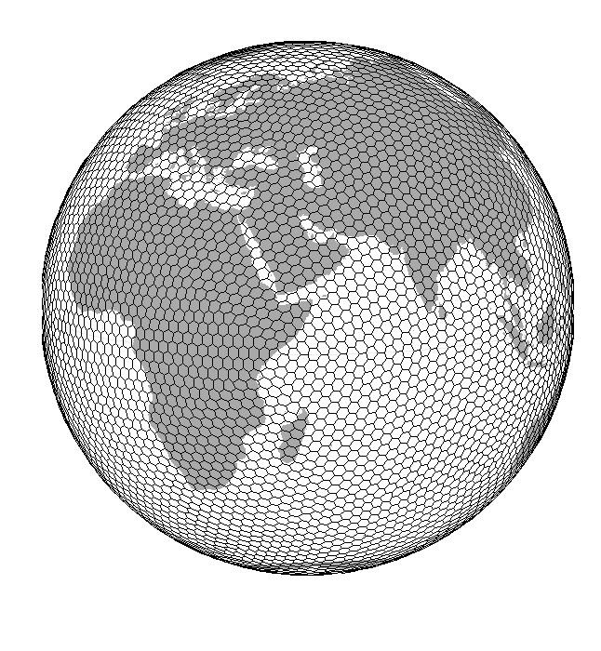
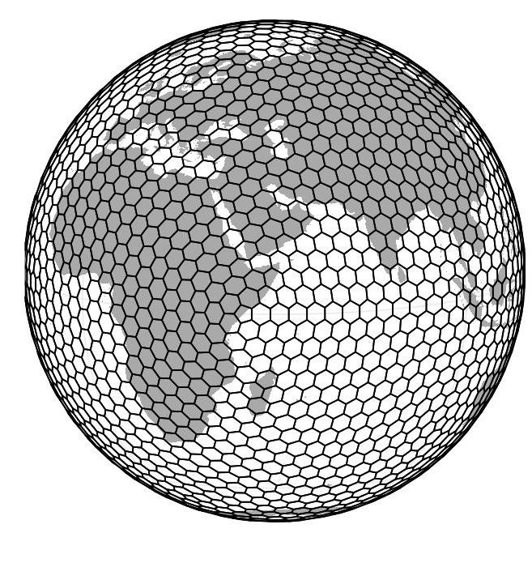


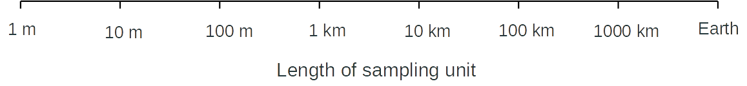
We can understand this through the optics of spatial grain
Spatial Grain [length of spatial unit]

Slide 30
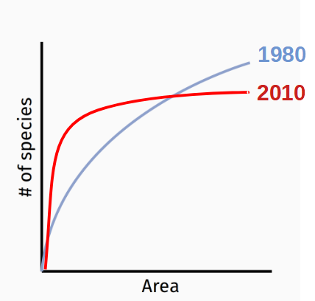
Biodiversity change is grain dependent
decrease
increase
Keil et al. (2011) Ecography
Powell et al. (2013) Science

Slide 31
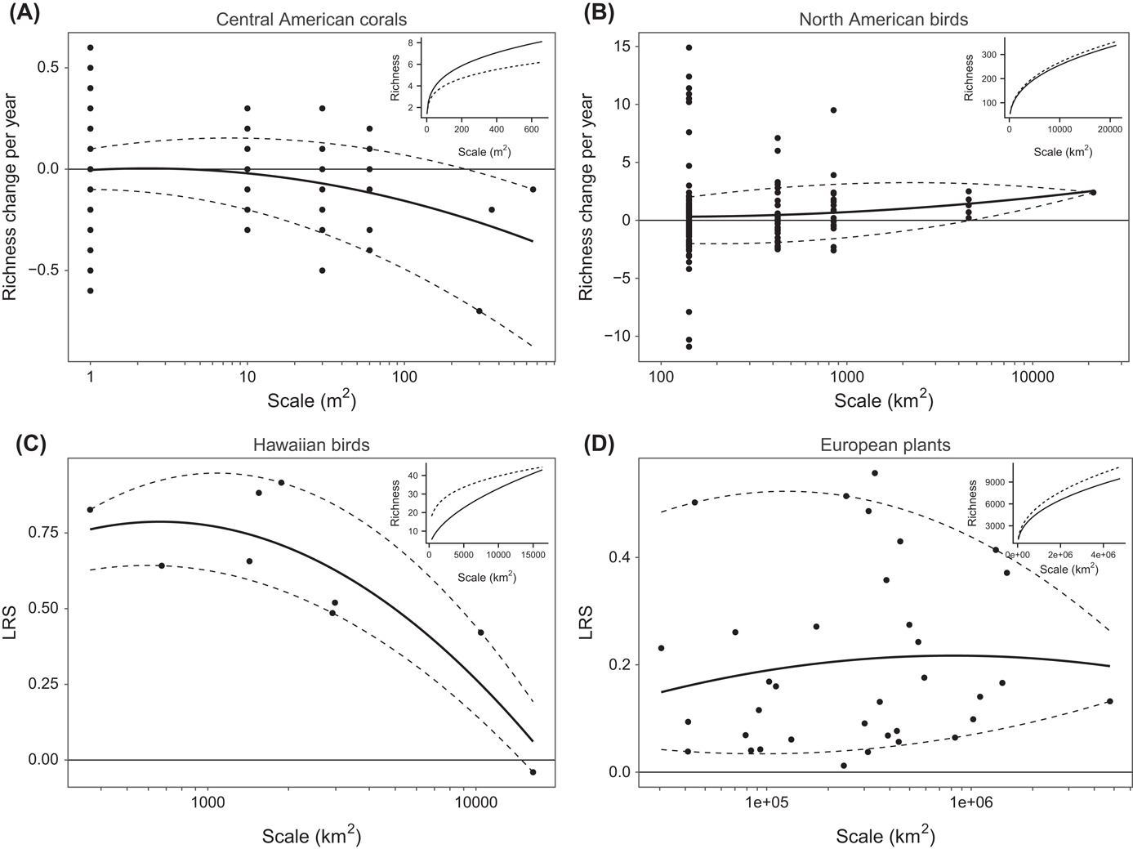
Empirical support for grain-dependent biodiversity change
Chase et al. (2019) Oikos

Slide 32

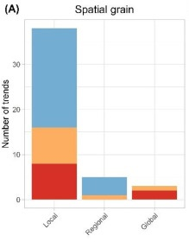
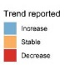
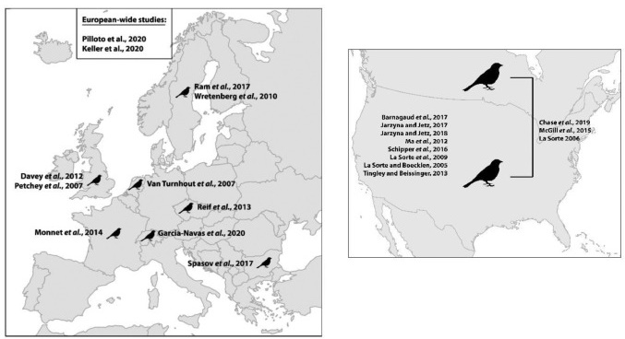
Empirical evidence for grain-dependent change – US and EU birds
Francois Leroy
Leroy et al. (2023) Basic and Applied Ecology
32

Slide 33
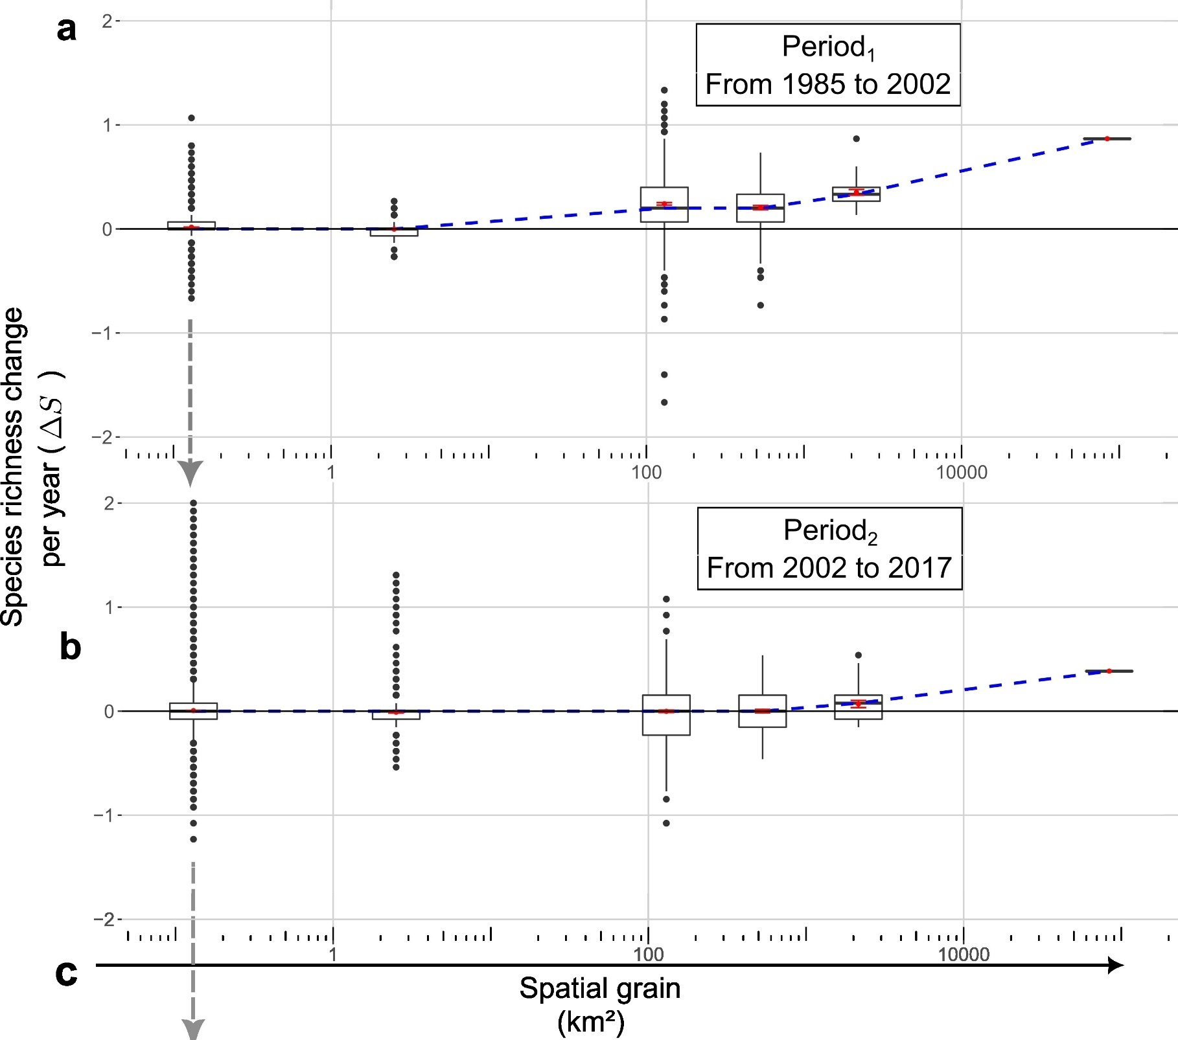
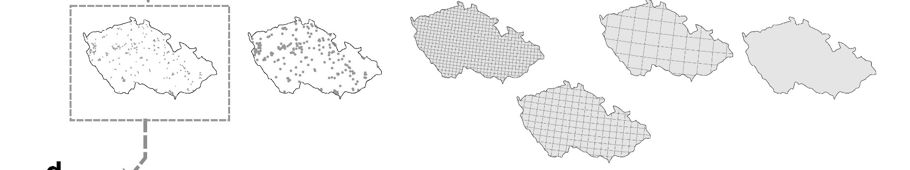
Grain-dependent change in Czech Birds
Francois Leroy
Leroy et al. (2024) Ecography
33

Slide 34
Processes behind scale-dependent biodiversity change
Gain and loss

Slide 35
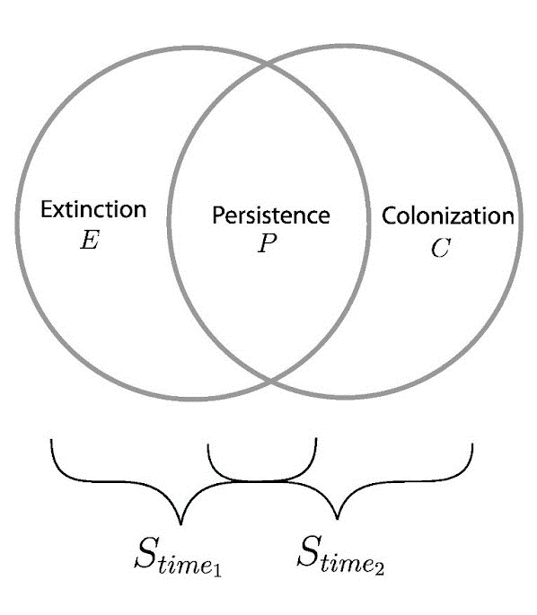
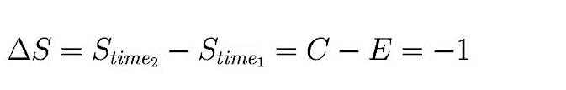
Decomposing biodiversity change to extinction and colonization (and persistence)
35

Slide 36
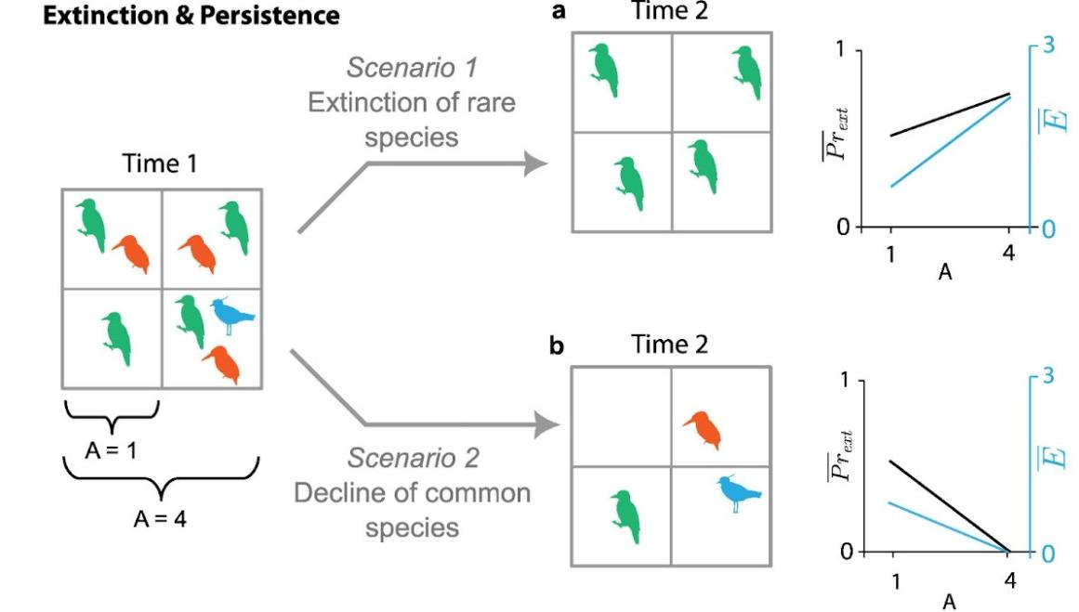
Loss of common vs rare species
Keil et al. (2018) Global Ecology and Biogeography
Leroy et al. (2024) Ecography

Slide 37
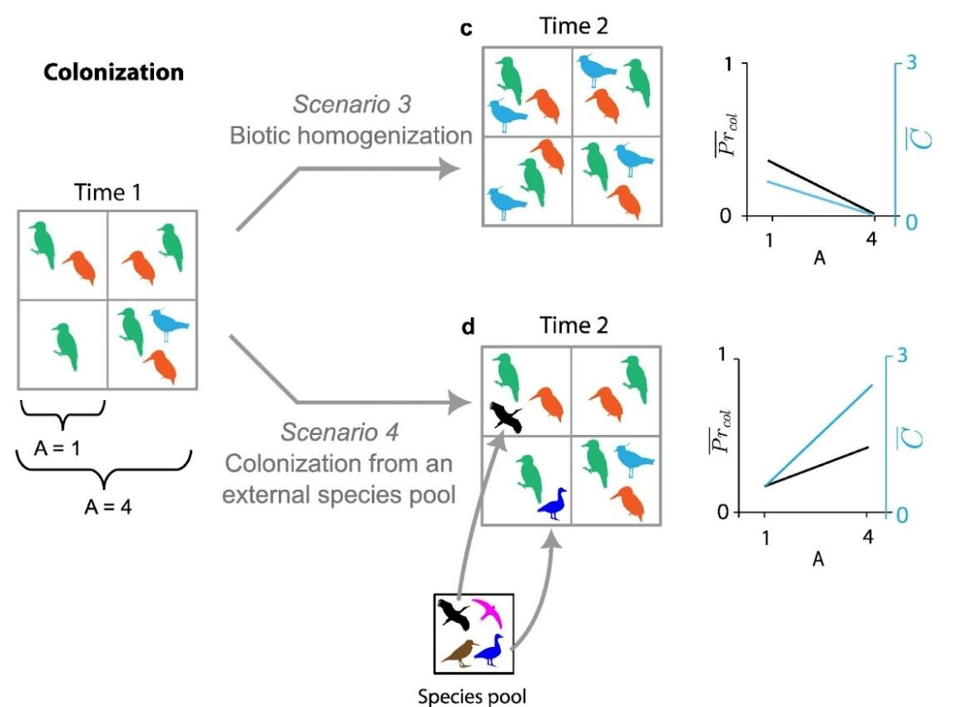
Spread of resident species vs. gain from the outside species pool
Leroy et al. (2024) Ecography
Francois Leroy

Slide 38
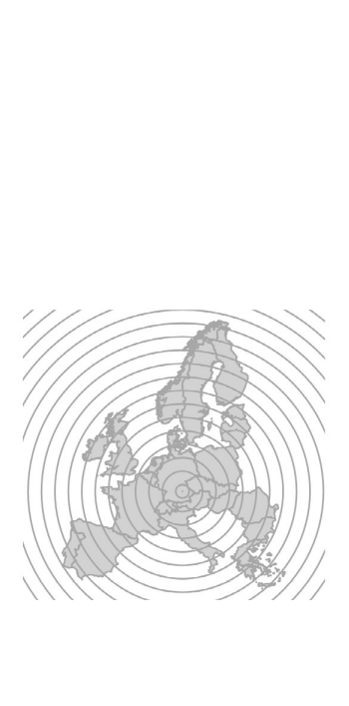
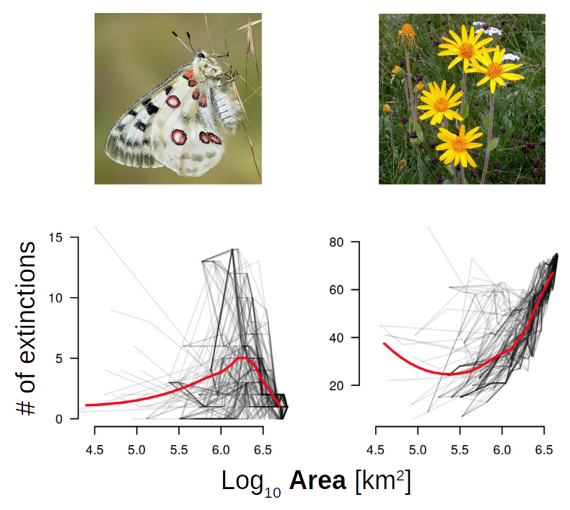
Grain-dependent extinction rates in European butterflies and plants
Keil et al. (2018) Global Ecology and Biogeography
38

Slide 39
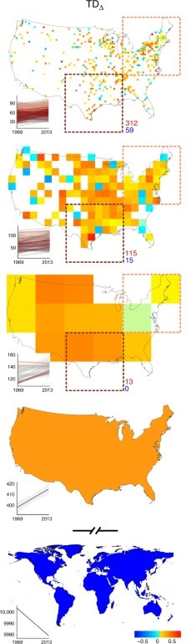
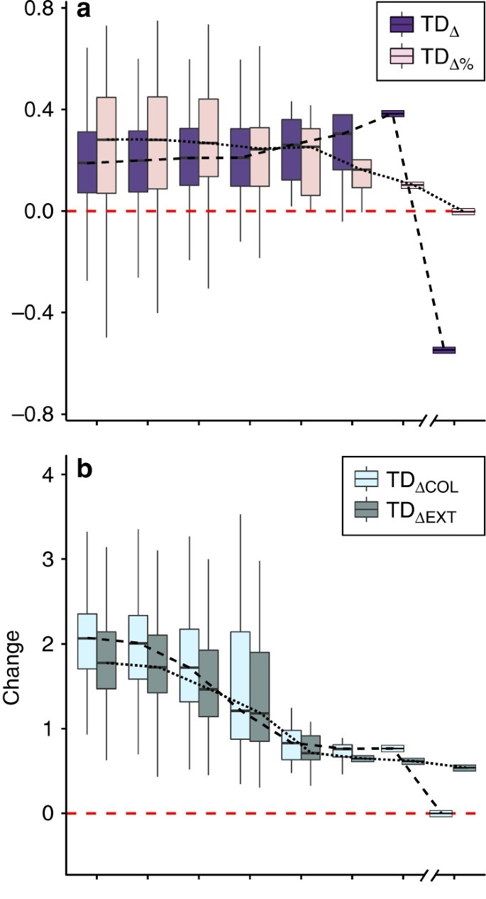

Grain-dependent extinction, colonization, and persistence in US birds
More increases of richness towards
coarse grains, then a drop globally.
Colonization decreases at a slower rate
with increasing grain.
Jarzyna & Jetz (2018) Nature Communications
39

Slide 40


Biodiversity change = colonizations - extinctions
Leroy et al. (2023) Ecography
Chase et al. (2019) Oikos
Spatial Grain [km^2]
Francois Leroy
40

Slide 41
Related concepts
STAR, rarefaction curves, endemics-area relationships

Slide 42


Species loss due to area loss: The Endemics-Area relationship (EAR)
Encountered species follow
standard species-area relationship (SAR)
Lost species follow
endemics-area relationship (EAR)
Deforestation of Borneo
He & Hubbell (2011) Nature
Keil, Storch & Jetz (2015) Nature Communications

Slide 43
Species loss due to area loss: The Endemics-Area relationship (EAR)
Encountered species follow
standard species-area relationship (SAR)
Direction of
loss
Species range
Lost species follow
endemics-area relationship (EAR)
He & Hubbell (2011) Nature
Keil, Storch & Jetz (2015) Nature Communications

Slide 44

Species loss due to area loss: It matters how habitats are lost
100%
Lost
biodiversity
We destroy from the outside
We destroy from within
Deforestation of Borneo
Destroyed living space
100%
Keil, Storch & Jetz (2015) Nature Communications

Slide 45


Species-time-area relationship (STAR) – species also increase with time
Adler et al. (2004) Ecology

Slide 46
Species accumulation curves: Individual-based rarefaction
Community 2
Community 1
# of Individuals
Gotelli & Colwell (2001) Ecology Letters
R package vegan by Jari Oksanen

Slide 47
Species accumulation curves – Sample-based rarefaction
Sample
Meadow
Meadow
Forest
Forest
# of Samples
Gotelli & Colwell (2001) Ecology Letters
R package vegan by Jari Oksanen

Slide 48
You should know
Apart from spatial grain, there is also temporal grain, and consequently a species-time-area relationship
SAR is related to “endemics-area relationship” (EAR), which can be used to estimate species loss from the loss of habitat area
SAR is a type of species accumulation curve, which also includes individual-based and sample-based rarefaction. These can be used to compare diversity of communities with different numbers of individuals.

Slide 49
Thank you. Questions?

